Slide 1
Cloud/AWS + CI/CD Workshop
Cloud
Computing
Jeremias A, Melissa F, Ghazal H

Slide 2
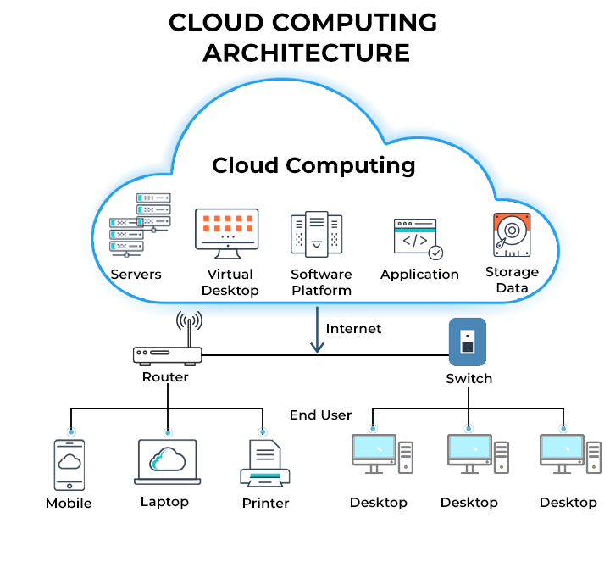
What is Cloud?
Remote Server
Online Storage Space
Applications Hosted
Computing Tasks
Notes:
Jerry

Slide 3

What is AWS
Amazon Web Services
Cloud computing platform
Scalable, cost-effective, globally accessible
200+ services
Notes:
Melissa

Slide 4
AWS Services
EC2
AWS Lambda
Aurora
Elastic compute cloud
Scalable
Serverless computing
Event response/Auto Manage
Relational Database Service
Stability, and Performance
S3
DynamoDB
Elastic Beanstalk
Simple storage service
Durable and Easily integrated
NoSQL Database Service
High availability and low latency
Deployment and Scaling
Pre-build service
Notes:
Ghazal

Slide 5
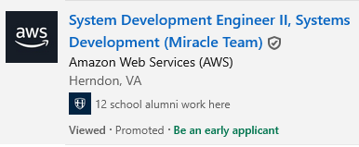

Why Learn AWS?
Sought out skill
Applicable to many fields
Useful in general
Notes:
Melissa

Slide 6
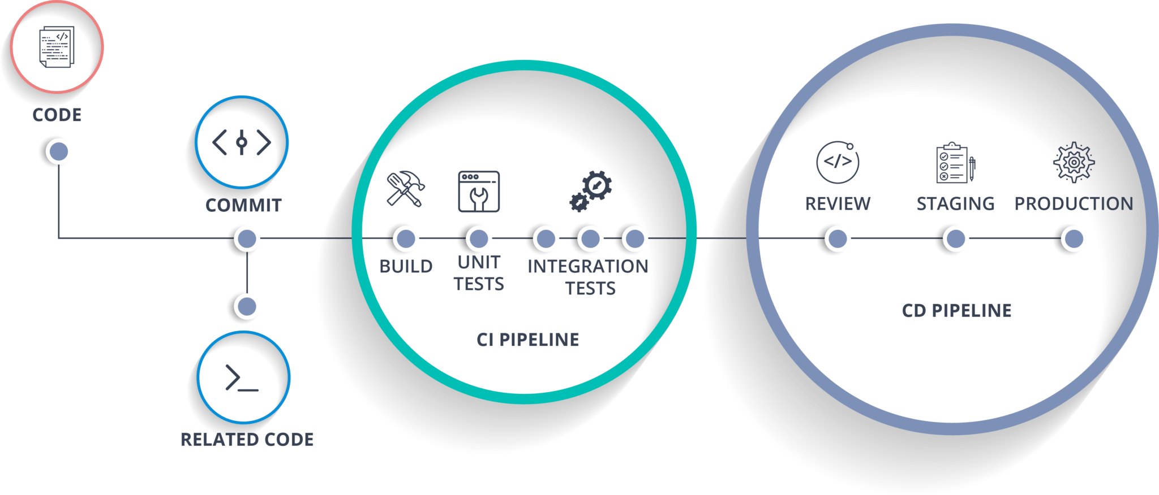
What is CI/CD
Continuous Integration and Continuous Delivery or Deployment
Code Testing and Auto Deploy
Notes:
Ghazal

Slide 7

$$
What is LocalStack
AWS = $$
Emulates AWS
AWS API
Open source
Docker
Notes:
Jerry

Slide 8
Outline
Download localstack
S3 Tutorial
Walkthrough
Activity
Exercise
DynamoDB Tutorial
Walkthrough
Activity
Exercise
Lambda Tutorial
Walkthrough
Activity
Exercise
Notes:
Jerry

Slide 9
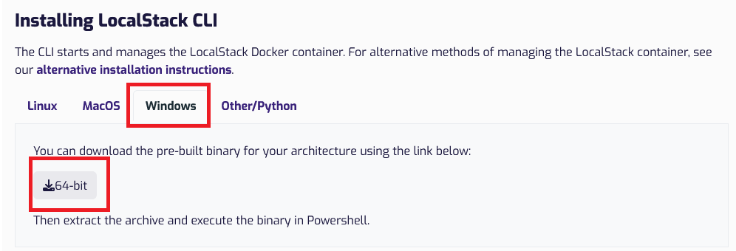
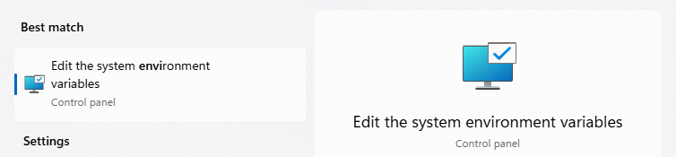
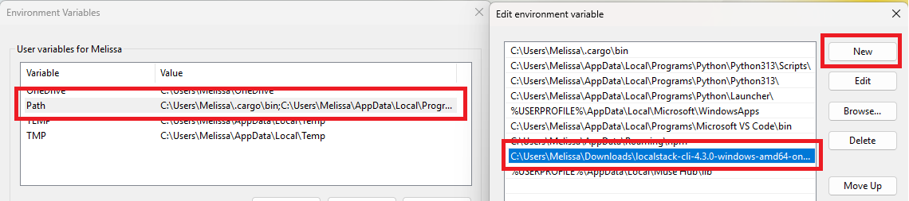
Downloading LocalStack
Open Docker: Both Mac and Windows
Windows
Mac
https://docs.localstack.cloud/getting-started/installation/
brew install localstack/tap/localstack-cli
localstack --version
Done!
If you need to download python for localstack
python3 -m pip install localstack
Notes:
Melissa

Slide 10
Starting
Powerpoint presentation and needed files:
Git clone https://github.com/ghxmi/wk-aws/
In docker:
docker pull localstack/localstack
localstack start -d
pip install awscli-local
pip install awscli
Notes:
Ghazal

Slide 11
Walkthrough 1: S3
awslocal s3 mb s3://test-bucket
awslocal s3api list-buckets
Try awslocal s3 ls if ^ doesn’t work
Notes:
jerry

Slide 12
S3 Activity : Da Bucket
Create
Upload
List
awslocal s3 mb s3://your-bucket-name
awslocal s3 cp yourfile.txt s3://your-bucket-name/
awslocal s3 ls s3://your-bucket-name/
Move
Download
Delete
awslocal s3 mv s3://your-bucket-name/yourfile.txt s3://your-bucket-name/new-folder/yourfile.txt
awslocal s3 cp s3://your-bucket-name/yourfile.txt downloaded-yourfile.txt
awslocal s3 rm s3://your-bucket-name/yourfile.txt
Notes:
jerry

Slide 13
S3 Exercise : Real-World Cloud Storage Management
Scenario: You are a Cloud Engineer responsible for managing log files in an S3-like environment (LocalStack). Your task is to efficiently organize, analyze, and archive log files.
Tasks:
Setup Storage- Create a Bucket, Create two folders in bucket
Simulate Log Collection- Generate three log files, Upload them to a folder
Manage Log Rotation-List all files, Move one file to another folder
Log Retrieval and Verification-Download one file to confirm contents, check the last modifed time
Challenge- Identify the largest file, Copy that file, delete the oldest file
Notes:
jerry

Slide 14
DynamoDB Walkthrough
To make a table
awslocal dynamodb create-table \
--table-name Users \
--attribute-definitions AttributeName=UserID,AttributeType=S \
--key-schema AttributeName=UserID,KeyType=HASH \
--billing-mode PAY_PER_REQUEST \
--output json
To view table:
awslocal dynamodb list-tables --output json
Make sure to add space before the \ and not add space after it
Notes:
ghazal

Slide 15
DynamoDB Walkthrough
To input
awslocal dynamodb put-item \
--table-name Students \
--item '{"StudentID":{"S":"101"},"Name":{"S":”John Doe"},”Major":{"S":"CS"}}’ \
--output json
To view table:
awslocal dynamodb get-item \
--table-name Students \
--key '{"StudentID": {"S":"101"}}’ \
--output json
Make sure to add space before the \ and ‘
Notes:
ghazal

Slide 16
DynamoDB Activity : Updating and deleting
Update the database by deleting grade
Guide:
Use update-item
Call the table
Use : --update-expression "REMOVE Grade" \
Output json
Check to see if it’s gone
Question: Why can’t we use delete-item instead of update-item?
To input
awslocal dynamodb put-item \
--table-name Students \
--item '{"StudentID":{"S":"101"},"Name":{"S":”John Doe"},"Grade":{"S":"CS"}}’ \
--output json
Notes:
ghazal

Slide 17
DynamoDB Exercise : Updating and adding
Update the database
Add is a Boolean attribute for the student enrolled status and set it to true
To input
awslocal dynamodb put-item \
--table-name Students \
--item ‘{"StudentID":{"S":"101"}}’\
--output json
Guide:
Use update-item
Call the table
Call the key
update-expression "SET IsEnrolled = :enrolled" \
Use expression-attribute-values '{":enrolled": {"BOOL": true}}’ \
Output json
Notes:
ghazal

Slide 18
DynamoDB Exercise : Solution
Guide:
update: awslocal dynamodb update-item \
--table-name Students \
--key '{"StudentID": {"S": "101"}}’ \
--update-expression "SET IsEnrolled = :enrolled" \
--expression-attribute-values '{":enrolled": {"BOOL": true}}’ \
--output json
Notes:
ghazal

Slide 19
Lambda Walkthrough: Hello Lambda
def lambda_handler(event, context):
name = event.get('name', 'Guest')
return {
'statusCode': 200,
'body': f'Hello, {name}!'
}
cd lambda
You can look at lambda_function.py in the folder
Package (zip) the file
awslocal lambda create-function --function-name HelloLambda --runtime python3.8 --handler lambda_function.lambda_handler --role arn:aws:iam::000000000000:role/execution_role --zip-file fileb://lambda_function.zip
awslocal lambda invoke --function-name HelloLambda --payload '{\"name\": \"Lambda\"}' output.txt
cat output.txt
Notes:
melissa

Slide 20
Lambda Activity: Lambda + S3
Steps:
Create a bucket or use an existing bucket
We’re now using the second lambda function in the python code
Deploy the second lambda function (you’ll need to change 2 things)
Create an S3 event notification (given below)
Test it by creating a file and moving it to the bucket
S3 event notification code (replace XXXXX with your function name):
awslocal s3api put-bucket-notification-configuration --bucket test-bucket --notification-configuration '{\"LambdaFunctionConfigurations\":[{\"LambdaFunctionArn\":\"arn:aws:lambda:us-east-1:000000000000:function:XXXXXXXX\",\"Events\":[\"s3:ObjectCreated:*\"]}]}'
Show logs:
awslocal logs filter-log-events --log-group-name /aws/lambda/XXXXXX
Notes:
melissa

Slide 21
Lambda Exercise : Transfer file
import boto3
s3 = boto3.client("s3")
destination_bucket = "destination-bucket"
copy_source = {"Bucket": bucket_name, "Key": file_key}
s3.copy_object(CopySource=copy_source, Bucket=destination_bucket, Key=file_key)
print(f"File {file_key} copied from {bucket_name} to {destination_bucket}")
Steps:
Create another bucket
Update the python function: lambda_s3
Repackage your code file
Rather than deploy, update
Create a new file
Upload it to the original bucket
awslocal s3 ls s3://destination-bucket/
Update function code (replace XXXXX with your function name):
awslocal lambda update-function-code --function-name XXXXXXX --zip-file fileb://lambda_function.zip
Notes:
melissa

Slide 22
Glossary
CI/CD : Software development practice that automates building, testing, and deploying applications.
Lambda function : Small, self-contained piece of code that runs in response to events without needing to manage servers.
Scalable – Being able to handle growing amount of work without breaking down or slowing

Slide 23
APPENDIX A: Technical tips and tricks
Use documentations and guide from Localstack: https://docs.localstack.cloud/user-guide/aws/feature-coverage/
AWS Educate is free and can be helpful with in-depth understanding of the service and it’s use: https://aws.amazon.com/education/awseducate/

Slide 24
Any Questions
Computing
THANKS!

